Slide 1
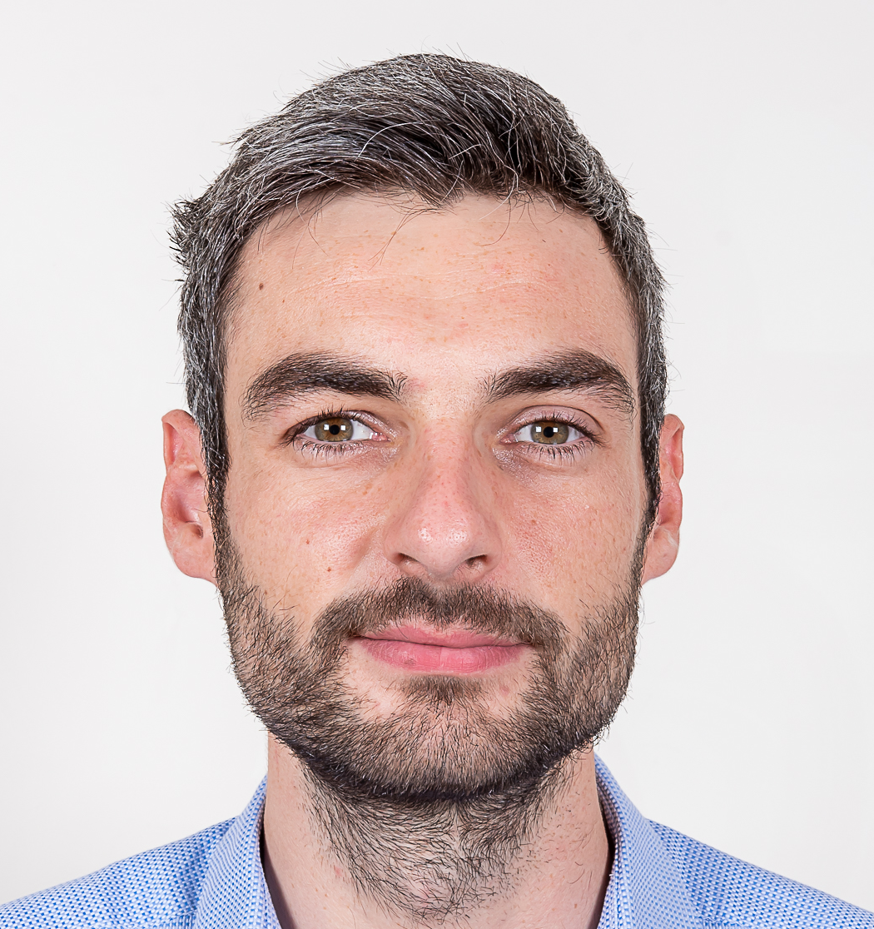


Lead Data
Final project
Mathieu Nicolle
Alumni Lead Data
Session 20/01 → 10/02
Netflix recommandation engine

Slide 2
Project goals
Folder = XXX
Create a recommandation engine using any AI library that you know of.
Create an infrastructure that ingest real-time user interactions on the platform.
Automatically produce real-time recommandations after a user finished a movie.
Source : https://app.jedha.co/course/final-projects-l/netflix-automation-engine-l

Slide 3




Recommandation engine
Folder = preprocess
data.csv (100M *4)
filtering_sample.csv
(100 000 *4)

Slide 4




Recommandation engine
Folder = preprocess
Folder = model_training
data.csv (100M *4)
filtering_sample.csv
(100 000 *4)
Train an SVD model that takes a User ID as input and returns the predicted ratings for each unseen movie by the user.

Slide 5


Ingest real time user interaction
Folder = kafka_streaming
Kafka
Current infrastructure

Slide 6
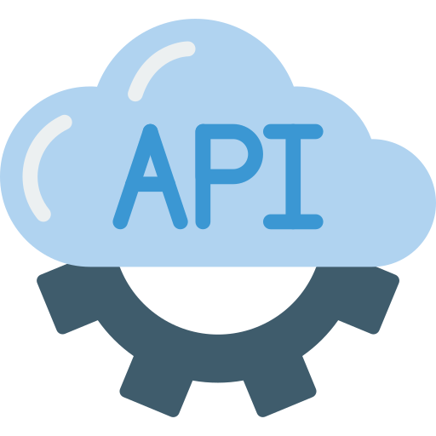
Ingest real time user interaction
Folder = kafka_streaming
Kafka
Producer
Current infrastructure
Every 15 sec

Slide 7



Ingest real time user interaction
Folder = kafka_streaming
Kafka
Producer
Consumer
Current infrastructure
Every 15 sec

Slide 8



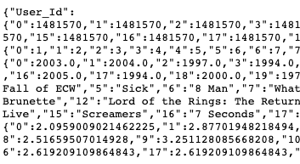


Real time recommandation
Folder = fastapideta & aws_server
Accessible at : https://fastapideta-1-a3617093.deta.app/
Host on
Current infrastructure

Slide 9

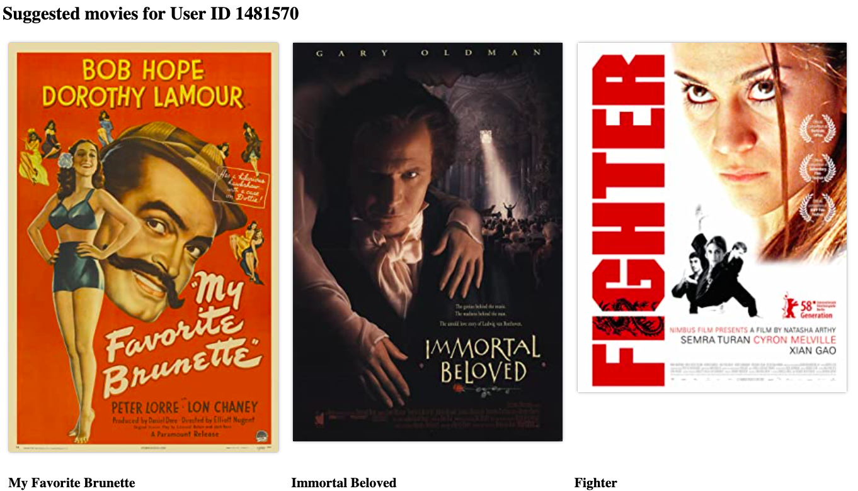


Real time recommandation
Folder = fastapideta & aws_server
Accessible at : https://fastapideta-1-a3617093.deta.app/
Host on
Accessible at : mnicolle.pro:8000
Host on
Current infrastructure

Slide 10
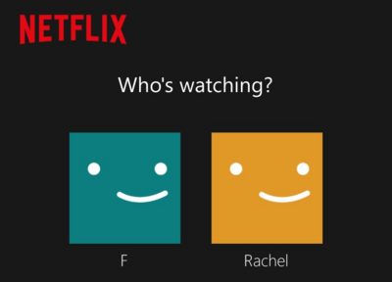

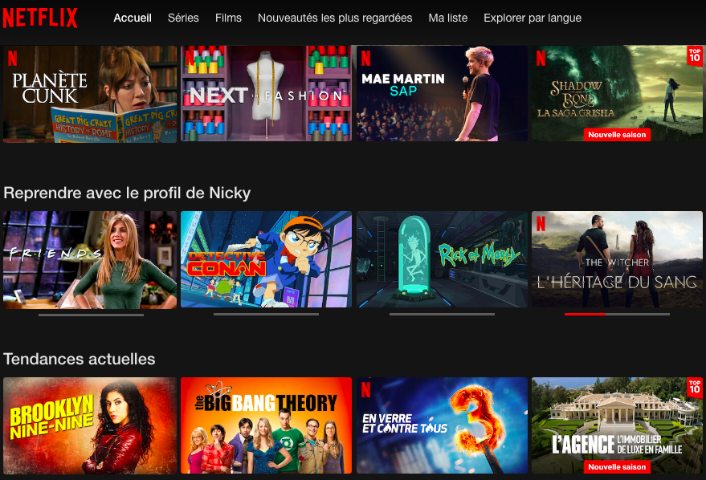
Final infrastructure

Slide 11
Final infrastructure

Slide 12
Final infrastructure

Slide 13
Final infrastructure
Database
Datalake

Slide 14
Final infrastructure
https://fastapideta-1-a3617093.deta.app/
Database
Datalake

Slide 15
Final infrastructure
Accessible at : mnicolle.pro:8000
https://fastapideta-1-a3617093.deta.app/
Database
Datalake

Slide 16

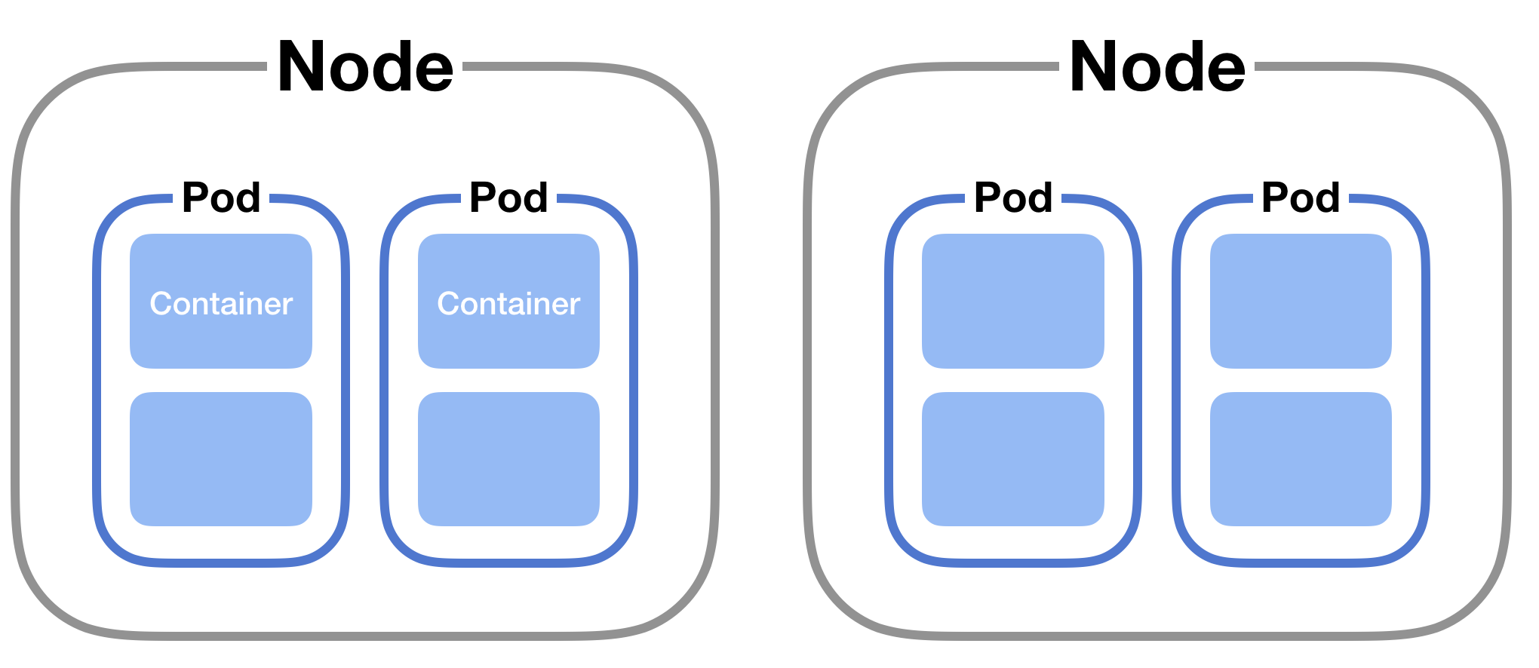
What’s next ?
Database
Datalake

Slide 17


What’s next ?
DataWarehouse
Database
Datalake

Slide 18
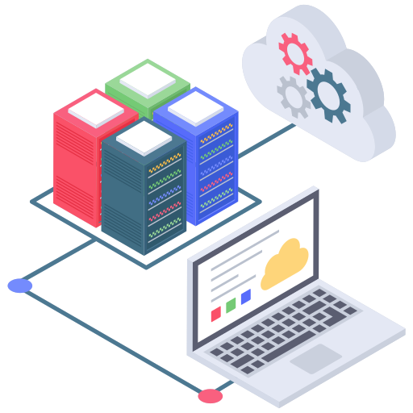


What’s next ?
DataWarehouse
Database
Datalake

